Slide 1
Boot Sequence

Slide 2
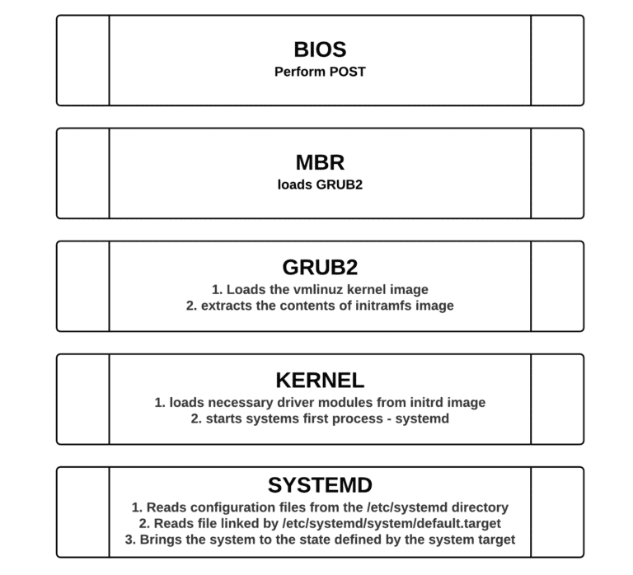
Introduction
It is important to understand the Linux boot process to troubleshoot boot problems.

Slide 3
BIOS
The BIOS (Basic Input/Output System)
  performs the POST (power on self test) to detect, test and initialize system hardware components.
  Loads the MBR (Master boot record).

Slide 4

Master boot record (MBR)
Master Boot Record (MBR) is the first 512 bytes of the boot drive that is read into memory by the BIOS.
  The first 64 bytes contain the partition table for the disk.
  The last two bytes are the “Magic Number” which is used for error detection.
  MBR discovers the bootable device and loads the GRUB2 boot loader into memory and transfers control over to it.

Slide 5
GRUB2 Bootloader
The default bootloader program used on RHEL 7 is GRUB 2.
GRUB stands for GRand Unified Bootloader.
  The GRUB 2 configuration file is located at /boot/grub2/grub.cfg (Do not edit this file directly).
  GRUB 2 menu-configuration settings are taken from /etc/default/grub when generating grub.cfg.

Slide 6
GRUB2 Bootloader Cont.
Sample /etc/default/grub file :
GRUB_TIMEOUT=5
GRUB_DISTRIBUTOR="$(sed 's, release .*$,,g' /etc/system-release)"
GRUB_DEFAULT=saved
GRUB_DISABLE_SUBMENU=true
GRUB_TERMINAL_OUTPUT="console"
GRUB_CMDLINE_LINUX="crashkernel=auto rhgb quiet"
GRUB_DISABLE_RECOVERY="true"
If changes are made to any of these parameters, you need to run grub2-mkconfig to re-generate the /boot/grub2/grub.cfg file.
  # grub2-mkconfig –o /boot/grub2/grub.cfg

Slide 7
GRUB2 Bootloader Cont.
GRUB2 searches the compressed kernel image file also called as vmlinuz in the /boot directory.
GRUB2 loads the vmlinuz kernel image file into memory and extracts the contents of the initramfs image file into a temporary, memory-based file system (tmpfs).
The initial RAM disk (initrd) is an initial root file system that is mounted before the real root file system.

Slide 8
GRUB2 Bootloader Cont.
The job of the initial RAM file system is to preload the block device modules, such as for IDE, SCSI, or RAID, so that the root file system, on which those modules normally reside, can then be accessed and mounted.
The initramfs is bound to the kernel and the kernel mounts this initramfs as part of a two-stage boot process.
  The dracut utility creates initramfs whenever a new kernel is installed.
  Use the lsinitrd command to view the contents of the image created by dracut

Slide 9
Kernel
The kernel starts the systemd process with a process ID of 1 (PID 1)

Slide 10
systemd
systemd is the parent of all processes on a system.
It reads the file linked by /etc/systemd/system/default.target (for example, /usr/lib/systemd/system/multi-user.target) to determine the default system target (equivalent to run level).
The system target file defines the services that systemd starts.

Slide 11
Systemd cont
systemd brings the system to the state defined by the system target, performing system initialization tasks such as:
  Setting the host name
  Initializing the network
  Initializing SELinux based on its configuration
  Printing a welcome banner
  Initializing the system hardware based on kernel boot arguments
  Mounting the file systems, including virtual file systems such as the /proc file system
  Cleaning up directories in /var
  Starting swapping

Slide 12
systemd target units
Target units have a .target extension.
Target units allow you to start a system with only the services that are required for a specific purpose.
To list the predefined systemd run level target units :
find / -name "runlevel*.target"
/usr/lib/systemd/system/runlevel4.target
/usr/lib/systemd/system/runlevel5.target
/usr/lib/systemd/system/runlevel6.target
/usr/lib/systemd/system/runlevel1.target
/usr/lib/systemd/system/runlevel2.target
/usr/lib/systemd/system/runlevel3.target
/usr/lib/systemd/system/runlevel0.target

Slide 13
systemd target units cont.
Target Units | Description
runlevel0.target, poweroff.target | Shut down and power off
runlevel1.target, rescue.target | Set up a rescue shell
runlevel[234].target, multi- user.target | Set up a nongraphical multi-user shell
runlevel5.target, graphical.target | Set up a graphical multi-user shell
runlevel6.target, reboot.target | Shut down and reboot the system

Slide 14
systemd target units cont.
To view which target unit is used by default use :
# systemctl get-default
multi-user.target
Notice that the default.target symbolic file points to graphical.target file.
# ls -l /etc/systemd/system/default.target
lrwxrwxrwx. 1 root root 40 Oct 11 02:02 /etc/systemd/system/default.target -> /usr/lib/systemd/system/graphical.target

Slide 15
systemd target units cont.
To change the default target unit to the graphical.target unit
# systemctl set-default graphical.target
rm '/etc/systemd/system/default.target'
ln -s '/usr/lib/systemd/system/graphical.target' '/etc/systemd/system/default.target'
To change currently active target
# systemctl isolate multi-user.target

Slide 16
Services

Slide 17
To Start and Stop
Services
Start a service
# systemctl start [service_name]
Example
  # systemctl start network
Stop a service:
  # systemctl stop [service_name]
Example:
  # systemctl stop network

Slide 18
To Check status of a service
# systemctl status [service_name]
Example
# systemctl status network

Slide 19
Enabling or disabling auto-start of a service
Enable auto-start a service at boot):
# systemctl enable [service_name]
Example:
# systemctl enable network
Disable auto-start a service at boot:
# systemctl disable [service_name]
Example:
# systemctl disable network

Slide 20
Listing services
List enabled/disabled status of all installed service units:
# systemctl list-unit-files --type=service

Slide 21
Print Tools
Print Tools

Slide 22
Introduction
CUPS, the Common UNIX Printing System, is the primary printing system in Red Hat Enterprise Linux.
Users can
  submit jobs with lpr or lp
  examine status with lpq or lpstat
  abort their jobs with lprm or cancel

Slide 23
Identify user printer
Users may specify a printer with an appropriate command-line option
If no printer is specified, both the lp and lpr commands look for a printer name by searching for a name in the following order:
  The environment variable PRINTER
  The environment variable LPDEST
  The first entry in /etc/printcap

Slide 24
Examples
$ lpr -P prn@arlin hrmph.text
$ lp -d prn@arlin hrmph.text

Slide 25
Configure printers using CUPS
The lpadmin command
  This text-only command allows you to
    add printers
    modify printers
    delete printers

Slide 26
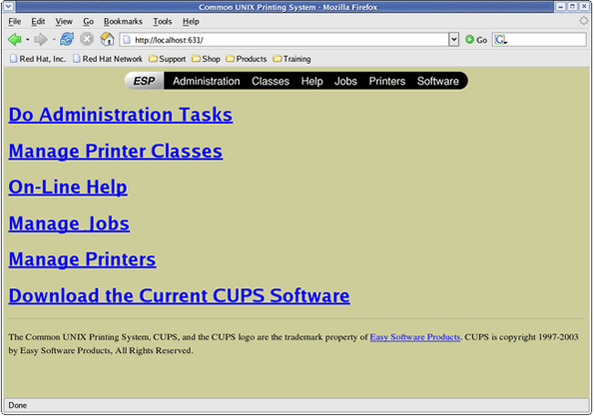
Configure printers using CUPS cont’d
The CUPS Web interface
  Running on port 631

Slide 27
Configure printers using CUPS cont’d
It can run either in a GUI-based environment (with system-config-printer)

Slide 28
The configuration files
The aforementioned commands modify the configuration files on your behalf
  The /etc/cups/cupsd.conf file contains configuration data about the CUPS daemon.
  The /etc/cups/printers.conf file contains configuration data about the printers.

Slide 29
Printer administration commands
To allows print jobs to go to the printer queue
  accept command
To disallows print jobs from going to the printer queue
  reject command
To Allows print jobs from going from the print queue to the printer.
  /usr/bin/enable command
To disallows print jobs form going from the print queue to the printer
  disable command

Slide 30
Scheduling and Processes
Scheduling and Processes

Slide 31
Task automation
Red Hat Enterprise Linux provides two utilities to manipulate and schedule tasks
  The at service
    Executes a task at a specific time
    Uses the at command to set up the execution of a task
    Is administered by the atd daemon
  The cron service
    Executes tasks at scheduled intervals.
    Uses the crontab command to set up the execution of a task.
    Is administered by the crond daemon

Slide 32
Access to the at command
/etc/at.allow and /etc/at.deny files restrict or allow users to run the at command.
If /etc/at.allow exists and your username appears in it, you may use at command.
If /etc/at.allow does not exist and /etc/at.deny does, then you must not be listed in /etc/at.deny to use at.
If neither file exists, all users are denied to schedule jobs with at.
The default installation supplies an empty at.deny file, thereby allowing the use of at to all users.

Slide 33
Use cron for task automation
Crontab files are stored in /var/spool/cron
Avoid modifying these files directly, use crontab –e command
The cron file format
Min(0-59) Hours(0-23) Day(1-31) Month(1-12) Day(0-6) command
Example
30 6 * * 0 /home/rania/mys1
Notes:
From 5 to 10
5-10
Jan and Feb
1,2
Every 20 min.
*/20

Slide 34
The /etc/crontab File
It automates the execution of system tasks. These tasks are often vital for the integrity of the operating system.
  # cat /etc/anacrontab
  SHELL=/bin/bash
  PATH=/sbin:/bin:/usr/bin:/usr/sbin
  MAILTO=root
  HOME=/
#period in days delay in minutes job-identifier command
  1 5 cron.daily nice run-parts /etc/cron.daily
  7 25 cron.weekly nice run-parts /etc/cron.weekly
  @monthly 45 cron.monthly nice run-parts /etc/cron.monthly

Slide 35
Managing System Logs
Managing System Logs

Slide 36
Introduction
The rsyslog system messaging features track system activities and events.
Log messages can be manually generated using logger command

Slide 37
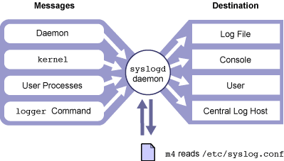
How rsyslogd Works ?

Slide 38
rsyslogd Configuration
File
/etc/rsyslog.conf file
  Selector
    Facility: category of system processes that generate the messages
      Example: kern, mail, daemon, cron, local0-7, *, …
    Level: severity or importance of the message
      Example: emerg, alert, crit, err, warning,…
  Action: where to send a message
    Example: /pathname, @hostname, username, *
      /pathname must already be exist

Slide 39
Monitoring a rsyslog File in Real Time
You can monitor the designated rsyslog file in real time using the command tail -f.
The tail -f command holds the file open so that you can view messages being written to the file by the syslogd daemon.
tail -f /var/adm/messages
jun 14 13:15:39 host1 inetd[2359]:[ID 317013 daemon.notice] telnet [ 2361] from 192.9.200.1 45800
Time/Date localhostname Pname[pid] MSG ID facility.level incoming request [ppid] IP Port name

Slide 40
Adding One-Line Entries to a System Log File
The logger command enables you to send messages to the rsyslogd daemon.
A system administrator can write administrative shell scripts that report the status of backups, or other functions by using the logger command.

Slide 41
Adding One-Line Entries to a System
Log File Cont'd
logger [ -i ] [ -f file ] [ -p priority ] [ -t tag ] [ message ]
Option | Description
-i | Logs the process Id of the logger command with each line
-f filename | Uses the content of the file as the message body
-p priority | Enters the message with the specified priority, the default is user.notice

Slide 42
Identify system log files
The /var/log/dmesg file
  Kernel log messages.
  This log file is written after system boot.
  It contains messages from the kernel that were generated during the boot process.
The /var/log/messages file
  It the standard system log file.
  It contains messages from most of your system’s services.

Slide 43
Identify system log files cont’d
The /var/log/maillog file
  Mail system messages
  It contains messages and errors from your mail service
The /var/log/secure file
  It contains messages and errors from security-related services such as login, network connections (xinetd)
  Very useful in detecting and investigating attempts to gain unauthorized access to the system.

Slide 44
Maintaining logs
Left unchecked, system logs will grow until you run out of disk space.
Red Hat Enterprise Linux provides logrotate, a powerful tool for log file maintenance.
Log files are rotated at predefined intervals.
logrotate can be configured to compress old log files to conserve filesystem space.

Slide 45
Maintaining logs cont’d
Example
  /var/log/messages is rotated weekly to /var/log/messages.1, with older log files rotated to /var/log/messages.2, etc.
  Generally, four weeks of log files are kept; older rotated files are deleted.
When you install a new system service by Red Hat Package Manager (RPM) that generates its own log file, it should "pre-configure" itself automatically for log file rotation by placing a configuration file in the /etc/logrotate.d directory.

Slide 46
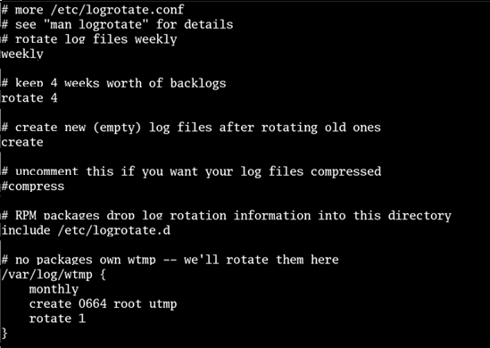
A sample of logrotate.conf File

Slide 47
Maintaining Logs
Monitoring system logs is an onerous but important task.
If you do not properly monitor your logs, you might miss
  Security problems
  Hardware problems
  Software problems

Slide 48
Maintaining Logs cont’d
The logwatch utility, can be installed, parses log files and generates a report that can either be printed or sent to a user via e-mail.
By default, logwatch runs nightly as a result of the 00-logwatch script located in the /etc/cron.daily directory. The result of this nightly execution is a report e-mailed to the root user.
The logwatch utility can be configured to detect almost any type of activity with the /etc/logwatch/conf/logwatch.conf file.
* See /usr/share/doc/logwatch-version (where version is the version of logwatch that you are using) for information on writing log filters.

Slide 49
Thanks :)

